Slide 1
SHOW ME THE MONEY!
RCSU Pacific J8 Accounts Payable
Training & Educational session
PO2 Keumhee(Lily) Bae
Maj Dustin Matheson

Slide 2
Claimable Expenses
Mandatory Activity reimbursement (TSR)
LSA reimbursement
Corps/Squadron Internet

Slide 3
What is a TSR?
TSR is Training support Request
Corps/Sqn Staff will submit a CSAR to request approval of a mandatory activity and the associated expenses.
RCSU will approve the CSAR and expenses IAW Training Directive issued each Trg year.
Some expenditure may be approved for ‘pay and claim’ or other eligible reimbursement.
Within 45 days of the end of the activity, the sponsoring committee should submit an invoice (Cdt 192) for eligible expenses paid by the sponsor directly related to the activity.
Include a nominal roll if entry fees and/or meals are on the invoice.
RCSU(P) is endeavoring to pay for all expenses for all supported Cadet activities up front.
Please include the TSR number on the invoice (Cdt 192).

Slide 4
What is LSA?
LSA (Local Support Allocation) is simply the method used by the RCSU to provide financial relief to help offset some costs of the corps/sqns sponsoring committees for the support they provide in support of the cadet program
Eligible expenses detailed in CATO 17-34

Slide 5
How is the LSA calculated and time frame?
$600 per corps/sqn + $45 per cadet per year
Based on strength in Fortress
Government fiscal year (FY) is 1 Apr to 31 Mar
To maximize on LSA reimbursement, we suggest invoicing RCSU for all your LSA expenses every 3 months (at the end of Jun, end of Sep, end of Dec and end of Mar).
RCSU CO will probably reallocate all unused LSA funds by 1 Feb.
If you plan on spending more then your allotment please make sure the SC is comfortable with the chance of not getting everything reimbursed.

Slide 6
LSA Categories
Cat. 1 – Optional training activities
Cat. 2 – Optional physical activities
Cat. 3 – Administrative support
Note: No need to separate your expenses by categories. There are no longer any restrictions on how much can be submitted from each category just a total amount of LSA per year. If you spend more then your allotment still submitted for reimbursement, we never know what will happen.

Slide 7
Eligible Expenditures Optional Training Activities
Musical instruments, music accessories & maintenance
Training aids & equipment
Maintenance of training aids & equipment
Transportation
Rations
Temporary accommodations
Temporary facilities
Entry fees
Any reasonable expenditure in support of an activity that is not financially covered by the RCSU as part of the Mandatory and Complimentary program

Slide 8
Eligible Expenditures Physical Activities
Purchase / rental / maintenance of fitness & sports equipment or training aids
Rental of fitness & sports facilities
Registration / entrance fees
Fitness related instructional services
Any reasonable expenditure in support of an activity that is not financially covered by the RCSU as part of the Mandatory and Complimentary program

Slide 9
Eligible Expenditures Administrative Support
Facilities for corps/sqn (ie. Rent)
Electricity
Telephone
Pens, paper and supplies
It is recommended that this be the target of the majority of LSA claims

Slide 10
Ineligible Expenditures
Annual League Assessments
Expenditures incurred for gifts and testimonials (i.e. aging out gift, coins, keepsake trophies, gift cards)
Hospitality expenses (receptions, food, drink, etc.)
Zoom
Virtual training; the formation will not approve the use of LSA funds for non-enterprise tools and applications related to virtual training.
Late fee charges due to not paying bills on time

Slide 11
No Reimbursement for:
“Gift card”
Or purchases paid with Gaming Grant
Gaming grant is government issued grant so we as government do not reimburse twice
if you don’t use your gaming grant, you might not get it next year.

Slide 12
Internet
RCSU is financially responsible to cover the cost of Corps/Sqn Internet Service Provider as long as it’s reasonable.
If sponsor are still paying and claiming for your internet, please contact Capt Rebecca Harris. Our goal is to pay the internet directly to the provider.
Corps/Sqn that are in DND building may already have access to the internet through GPnet.

Slide 13
Documents required for reimbursement
Cdt192 invoice signed by sponsoring committee and CO (this form must be used for all reimbursement requests to the sponsoring committee
* DO NOT use general allowance claim (CF 52) for reimbursement of
LSA or TSR expense
2. Original receipts taped on blank paper or invoice showing what was
purchased, date, vendor name
3. Proof of payment such as bank statement

Slide 14
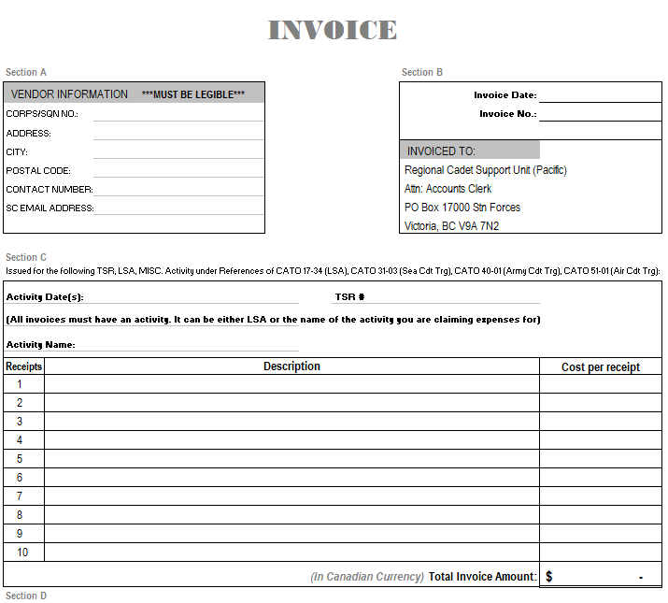
INVOICE
Cdt 192
Where, What, Why

Slide 15
Process ...creating an invoice
Section A
Corps/Sqn info (to a minimum corps/sqn # and RCACS, RCACC or RCSCC and full address)
Contact info where we can ask questions if we have one.

Slide 16
Section B
Invoice Date - date you create the invoice
Invoice Number – generated by the Corps/Sqn sponsor as a tracking mechanism. Is mandatory in order to process invoice.
It should be the corps/sqn number or UIC, the year you submit the invoice and a 2 to 4 sequential number. ei. 9072021002
Max is 15 characters including spaces
This invoice number is used as a reference on the direct deposit email which you will receive a few days before the deposit actually happens.

Slide 17
Section C
Activity Date
for LSA, put the date range of your receipts
ei: 1 Apr – 30 Sep 2021
for a TSR, it’s the actual date of the activity
Activity Name
for LSA, just write “LSA”
for a TSR, write the actual name of the activity (As named on the CSAR)
TSR #
for LSA, leave blank
for a TSR, please always include the number outlined in CSAR

Slide 18
Section C (continuous)
Description
One receipt per line
You can attach up to 10 receipts per invoice
If there are more than 10, attach a spread sheet to the invoice with the details of all the receipts attached
A good description could be:
- Vendor’s name / name of vendor/store where purchased
- What was purchased
- For what reason (short and sweet)
For a receipt to be reimbursed, the original itemized bill with proof that the vendor receipted the payment is required (debit/credit slip, copy of cleared cheque, receipt, zero balance)

Slide 19
Section D
We need a representative of the sponsoring committee to sign saying they agree with the expenditure on the invoice.
We need the CO of the corps/sqn to certify the goods and services on the invoice have been received.
Please include phone numbers in case there are questions.

Slide 20
Please include the TSR number on the invoice (Cdt 192).
Keep all receipts for one approved activity (TSR) on one invoice (Cdt 192).
Keep LSA separate from TSRs if possible.
When taping receipts to blank paper do not tape any writing. The writing under the tape will disappear within 2 weeks.
Do not complete invoice (Cdt 192) with pencil. It’s a financial document and are required to be kept on file for 7 years.
We can only reimburse if we have the actual full bill (ex. all the pages of your Shaw or Telus bills). And we reimburse the actual cost charged for that month (not pre installment amt)
When purchasing catered meals (ex. pizza), we need to see what was purchased and that it was paid.
Please ensure contact info is present and accurate.

Slide 21
Invoice Register - for sponsoring committee to keep track

Slide 22
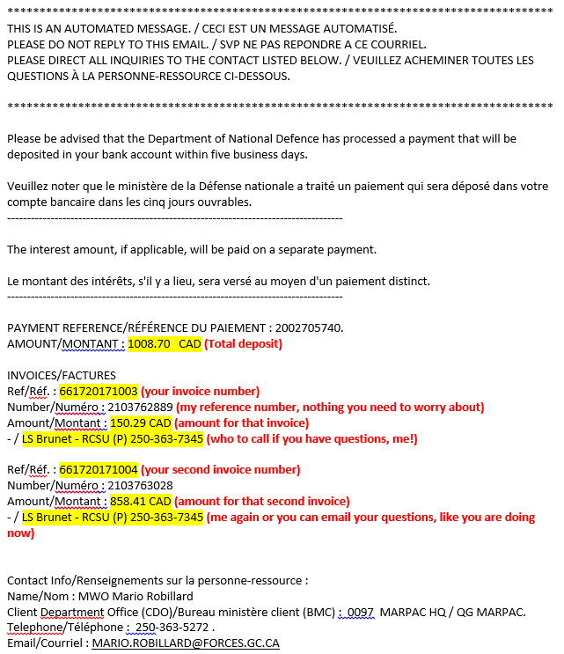
Deposit email automatically generated by the invoice payment system.

Slide 23
For the Direct deposit
Monitor your generic e-mail address regularly and is passed on to the next sponsoring committee representative.
Must let us know prior closing your bank account and complete a DND 2968 with the new account information.

Slide 24
Funds
Supported Activities
TSR
Internet
LSA

Slide 25
Submit all! You never know!
Significant improvement has been made over the past number of years; almost all Corps/Sqns used their LSA entitlement. However, CO RCSU may redistribute any residue. Submit all eligible expenses as soon as possible.

Slide 26
Mailing original documents
If you have an invoice with all electronically/digitally issued receipts, these can be emailed.
If you have any hardcopy paper receipts, mail everything be to us.
Please use normal regular mail
Please try not to waste money on Express Post/Priority Post/couriers. It usually takes longer to get the mail because these require signature for someone to get the package.
Notes:
the base receives the package, sends us the note on a card in the mail, to come sign for the package and then someone goes to get the package or gets the note sign and then goes and gets the package. By the time we get all those steps done, we would have received your package in the normal mail.

Slide 27
Contacts
PO2 Keumhee(Lily) Bae
keunbee.Bae@forces.gc.ca
250-363-7351 (office)
Links:
Air https://bc-aircadetleague.com/ssc-resources-2/lsa-invoicing-other/
Land https://britishcolumbia.armycadetleague.ca/document-library/
Sea ML https://bcmainland.ca/resources
Sea VI https://vidcadets.ca/resources

Slide 29
1- From what date to what date is my FY?
2- Why do you need to put an invoice number on your invoice?
3- Should the officers use CF 52 to get reimbursed for supported activities?
What should be used?
4- Should you mix LSA and supported activities expenses on the same invoice?
5- What should you attach to the invoice to qualify for a reimbursement?
6- Where do you get the TSR # from?

